Slide 1
Introduction to image registration methods for 2D and 3D image data:
Joost de Folter
Francis Crick Institute, London

Slide 2
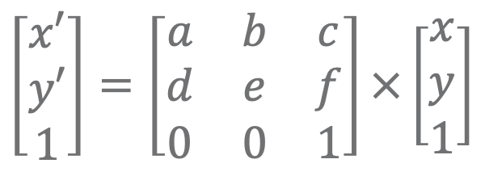
Affine transforms
An affine transform allows images to be rotated, scaled and sheared
Any affine transform can be defined by a transformation matrix
Transformed points can be calculated with matrix multiplication
$$\left[\begin{matrix}x′ \\ y′ \\ 1\end{matrix}\right]=\left[\begin{matrix}a & b & c \\ d & e & f \\ 0 & 0 & 1\end{matrix}\right]×\left[\begin{matrix}x \\ y \\ 1\end{matrix}\right]$$

Slide 3
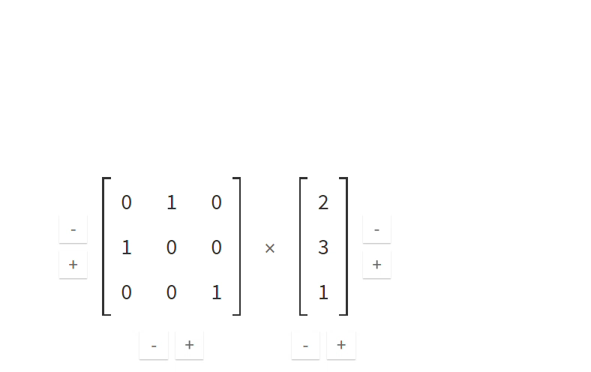
Transforms example

Slide 4
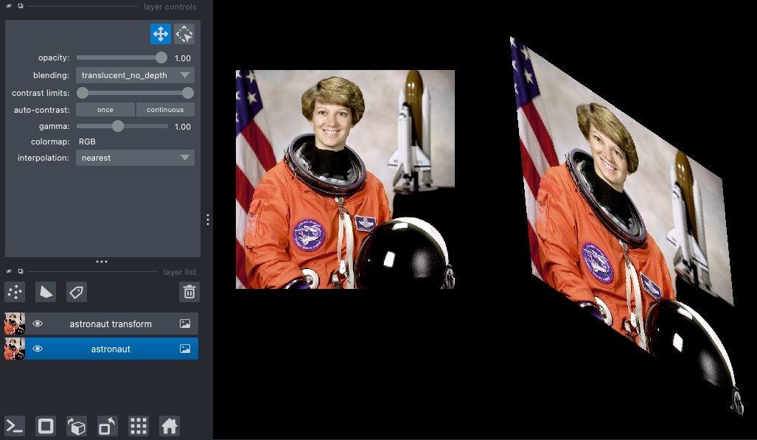
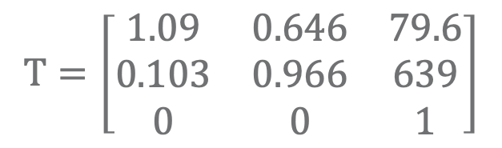
Transforms in napari
Affine transform matrices can be applied to napari layers
Two images can be registered if the correct matrix is known
$$T=\left[\begin{matrix}1.09 & 0.646 & 79.6 \\ 0.103 & 0.966 & 639 \\ 0 & 0 & 1\end{matrix}\right]$$

Slide 5
2D image registration (manual)
Select a set of points in a reference image using a points layer
Select matching points in a moving image
Both sets of points can be used to estimate an affine transform matrix
Apply the transform matrix to the moving image layer to register the images
Follow along with napari plugin (e.g. https://github.com/jni/affinder)

Slide 6
2D image registration (automated)
This process can be automated
Use SIFT to extract points in both images
Use RANSAC to find the matching points in both images
Use the matching points to estimate the affine transform
Demo this in jupyter notebook

